Slide 1
Telling data stories with gganimate: the GIFt that keeps on giving
Joshua Bird
Senior Policy/Analysis Officer
Notes:
Say first off that in contrast to many folk here I’m not a programmer or data scientist by training – did a first degree in politics and economics and then a graduate degree in public policy. So much of our analytical work was done in SPSS and Excel. It wasn’t until a few years into my career that I was switched on to R, by none other than MS himself. As such I learned R chiefly through Stackoverflow and Youtube tutorials and I must admit that it took me much longer that I’d like to admit to learn some concepts… e.g. I didn’t know that when you booted up a new session and wanted to use the Tidyverse I didn’t have to reinstall the package. The library function eluded me. Anyway this is a long winded way of saying that I apologise in advance if some of the concepts may seem somewhat pedestrian or if my code is messy etc.
Has anyone ever heard of SFC?

Slide 2
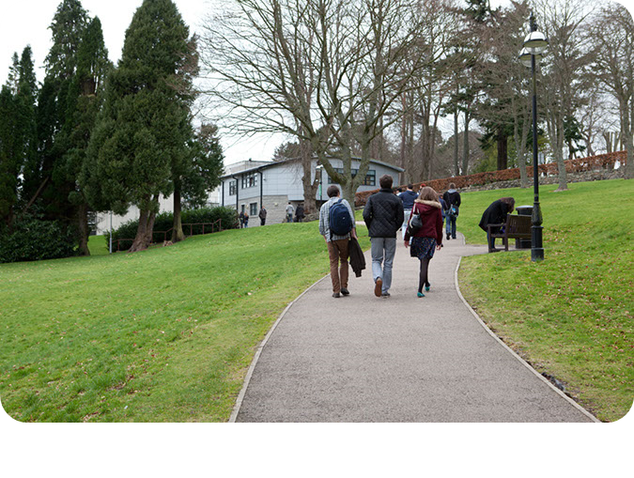
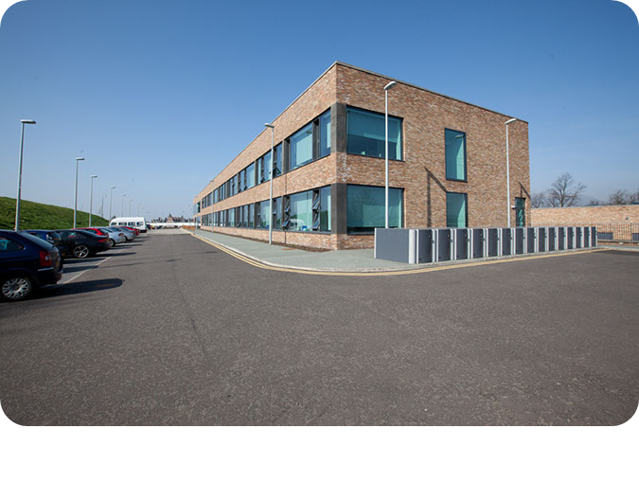
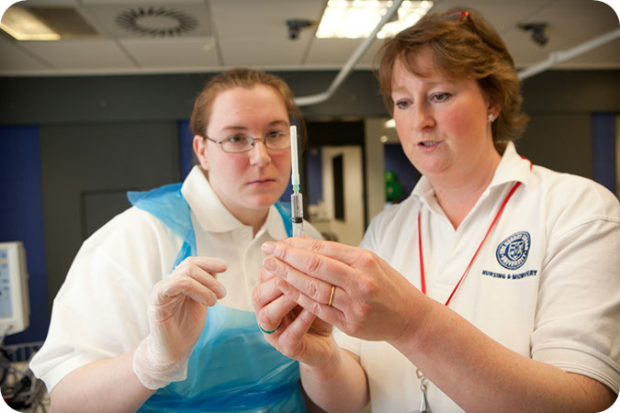
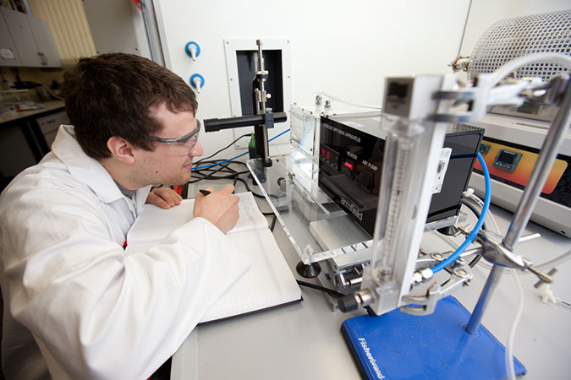
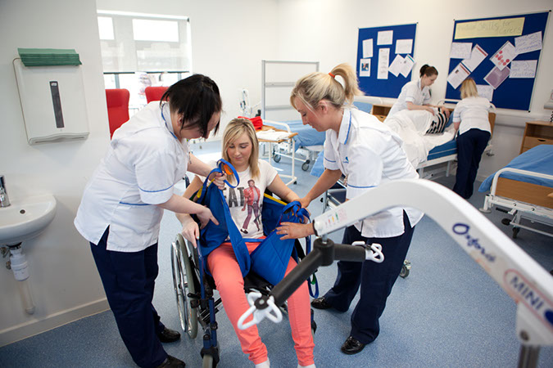

SFC allocates ~£2bn in public funds to Scotland’s 19 universities and 25 colleges each year for:
Skills development
Other costs such as staff, buildings and equipment
Widening access to further and higher education
Student support funds (for college students)
Learning and teaching
Research and innovation
Notes:
What SFC is and stuff – public sector arm’s length body.
Our main activities are: Progressing national priorities Supporting collaboration between colleges and universities Making payments to colleges and universities and other statutory functions. Just as a bit of background, we work especially close with colleges because in contrast with universities such as this which source their funding from all over the place, we fund colleges to the tune of 99% or more. So much of my work focuses on those institutions and therefore much of what follows will centre on issues the college sector faces and how gganimate can help communicate these.

Slide 3

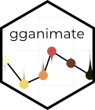
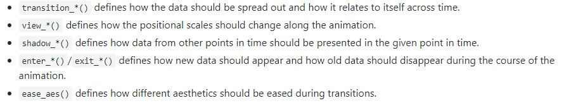
Telling data stories
Notes:
Most people here probably work in academia, but for those of you who have either worked in the public sector or have worked with people who work in the public sector, you’ll know that they people who ‘do’ data are often not the people that can make the sort of strategic and/or operational decisions that can be leveraged from data driven insights. In other words, senior managers don’t really know that much about data and in some dire cases don’t really care about it, so I’ve found that in trying to explain dense concepts it helps tremendously if you can include some kind of graph or chart to communicate your point, you know to SHOW rather than TELL… and if that graph or chart moves, then you’re cooking
If you’re an R user you will have definitely heard of Ggplot, one of the better application programming interfaces out there. Who uses it? So ggplot is good, but what gganimate does is basically extends the API by providing a new set of grammar for specifying transitions and animations in a flexible and easy to use way. These are the functions that are added to any plot object to determine how it will change with time. You needn’t memorise these because I’ll be showing how they’re used in practice later
I first heard of the package about a year ago but at that time it wasn’t on the CRAN, which complicated things because, in the public sector we typically have quite effective firewalls – and I’ve never had a problem installing a package in my R terminal but for whatever reason the SFC firewall didn’t like me trying to get the development version via github… and paradoxically there seems to be an inverse relationship between the enthusiasm of the firewall and that of the IT personnel who has the power to solve this problem. Seriously I tried every stackoverflow workaround and every rhetorical trick in the book to get it installed but got stonewalled every turn – so it was only in the last few months that I’ve been able to start making these sweet graphics!
So anyway let’s get into it

Slide 4
Essential Concepts:
Packages:
Library(gganimate)
Library(transformr):
For manipulating the shapes of polygons and paths
Library(gifski)
GIF renderer
“Tweening”
Notes:
Here’s some more conceptual stuff. First, the packages you’ll need
Obviously gganimate
You’ll also need tranformr, which basically provides a framework for polygon and path manipulation
Finally you’ll need gifski, which is a gif renderer and I’ll come to that shortly
You’ll hear me periodically mention the word tweening, short for ‘inbetweening’. I don’t have any background in animation but basically tweening refers to the process of generating intermediate frames between two images to give the appearance that the first image evolves smoothly into the second image – I’ll come back to this shortly. Very frustratingly PowerPoint does not handle the gif format very well, and we’ll see why shortly

Slide 5
Making a GIF
Four essential components:
ggplot2 code
gganimate grammar
animate()
gifski
anim_save()
Notes:
Animate verb is called which passes the frames to a renderer function which combines them into a final animation. In this case the default renderer is gifski, which was a package I mentioned. It’s the only renderer I’ve ever used but you can use any format you like. In any case this is where you can specify things like size, duration, frames per second, and so on.
The final step is anim_save which, as the name suggests, saves the animation to a specific location. It’s like ggsave in that it defaults to taking the most recently rendered animation and writing it to a file

Slide 6
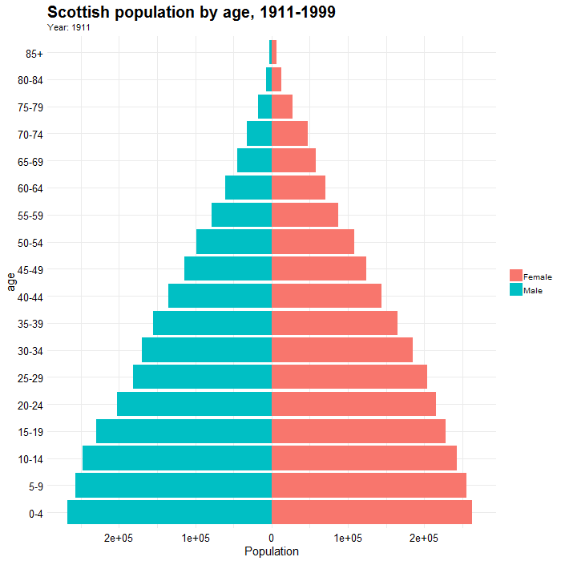
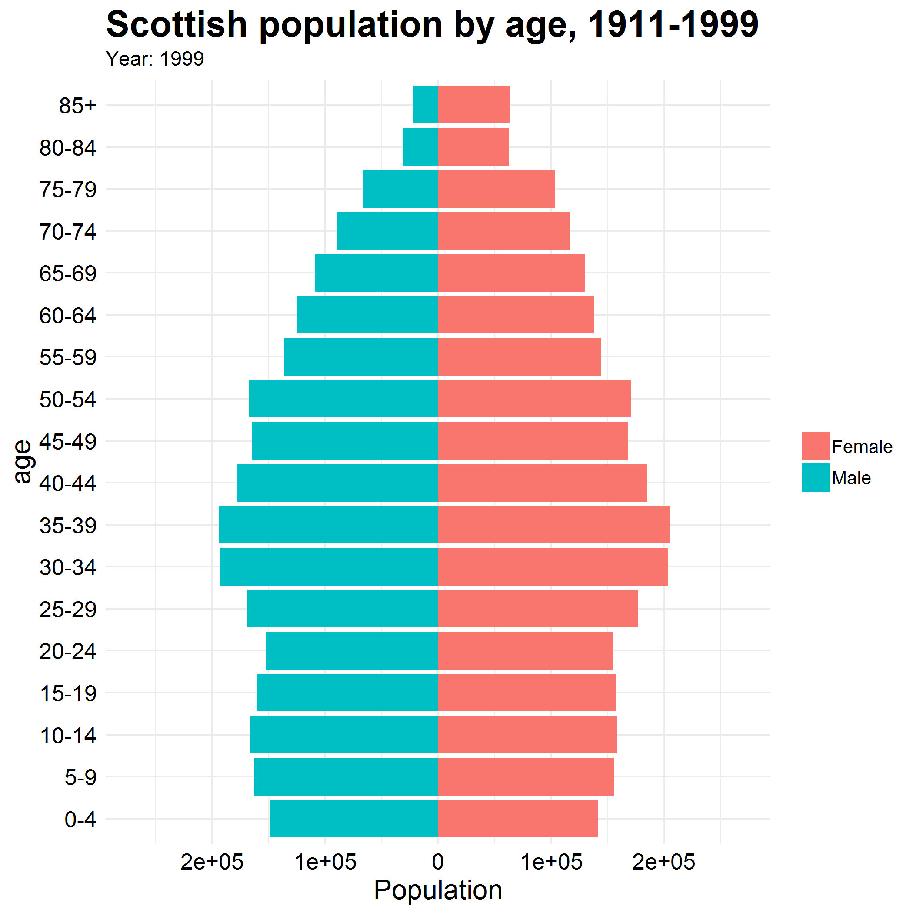
popgif2 <- popdata %>%
filter(Year >1910, Year <2000) %>%
ggplot(aes(x = age, fill = gender, y = ifelse(gender== "Male", yes = -total, no = total))) +
geom_bar(stat = "identity") +
scale_y_continuous(limits = max(popdata$total) * c(-1,1), labels=abs) +
coord_flip() +
theme_minimal() +
labs(y = "Population", title = 'Scottish population by age, 1911-1999', subtitle = 'Year: {frame_time}') +
transition_time(Year) +
ease_aes('linear')
animate(popgif2, end_pause = 10, width = 700, height = 700)
anim_save(filename = 'popfirst.gif')
Notes:
So that’s all the background stuff, let’s jump into the meat and potatoes. I’ll show you a basic example of how to create a gif. I’ll say here that I’m not going to walk everyone through the data tidying steps because I’m sure you’re all old hats at that. I find that with these sorts of things it’s easiest to first show and then walk through the code
*show it*
So as you’ve probably gathered, what this shows is the population change in Scotland over the 20th century. This data comes from the National Records of Scotland.
This was the code used to produce this. I’m sorry it looks so messy but the SFC boilerplate slides don’t have a keep source formatting option but I didn’t realise until much too late. I should note that I changed up the theme call a bit so this code is truncated due to space… as with most things ggplot you have to fiddle around a bit with it before you’re happy with the look, but the rest is as is. Once you have produced your chart it is actually quite easy to then make it do stuff
The first element is the subtitle, which is easy enough
Then I’ve used a ‘transition’ call, which defines how the data should be spread out, and I’ve specified that our year variable will define how it changes
Finally, I’ve used the ease_aes call, which defines how values change during tweening. There are a variety of options to choose from but I’ve opted for linear here. And that’s basically it!
Questions????
Coming back to the original point, this presentation is about telling data stories, as in the data is not the end itself but rather the means to the end. So let’s take an example that’s relevant to the college sector. We know that as with many countries in the western world Scotland’s population is ageing very quickly

Slide 7
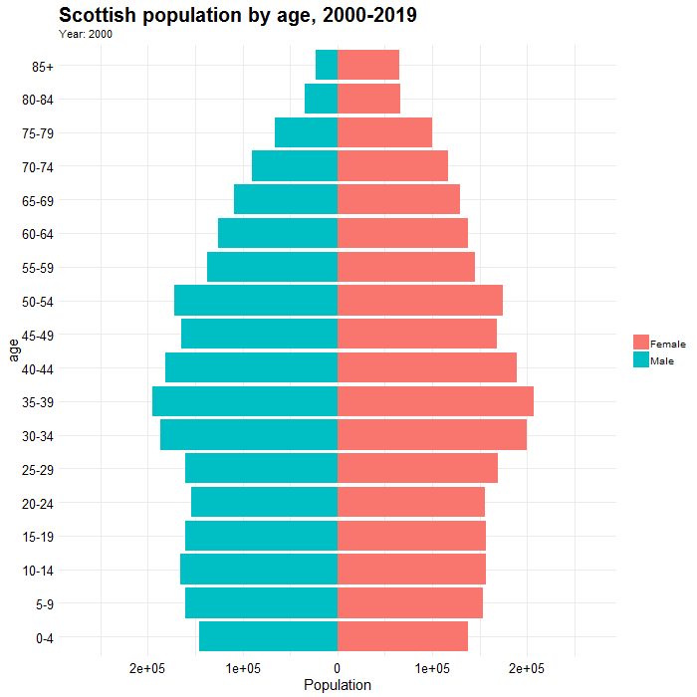
transition_time(Year) +
ease_aes(‘linear')
animate(popgif3, nframes = 200, fps = 20, duration = 10, end_pause = 10, width = 700, height = 700)
Notes:
Moving right along, here is our frame from 1999. In that graph we had quite a long time series, but the same code applied to a shorter time series made it appear quite choppy, so what I’ve done is prepare the same graph from 2000 until the present day. In the animate call there are all sorts of customising you can do, and in order to optimally smooth things out I’ve found that the best way is to time how long your gif is, and then make sure the product of your frame rate and your duration is broadly equivalent to the number of frames in the gif – there doesn’t appear to be any hard and fast rule but this is what has worked for me. The only trade off is that the more you fiddle with it the longer it takes to render, the last slide took about 40 seconds and one took about 2.5 mins so, your mileage may vary.
You may be thinking this gif doesn’t look any smoother than the last one but that’s because powerpoint doesn’t render embedded gifs very well, especially with enhanced framerates. If we look at it in the browser it does improve somewhat

Slide 8
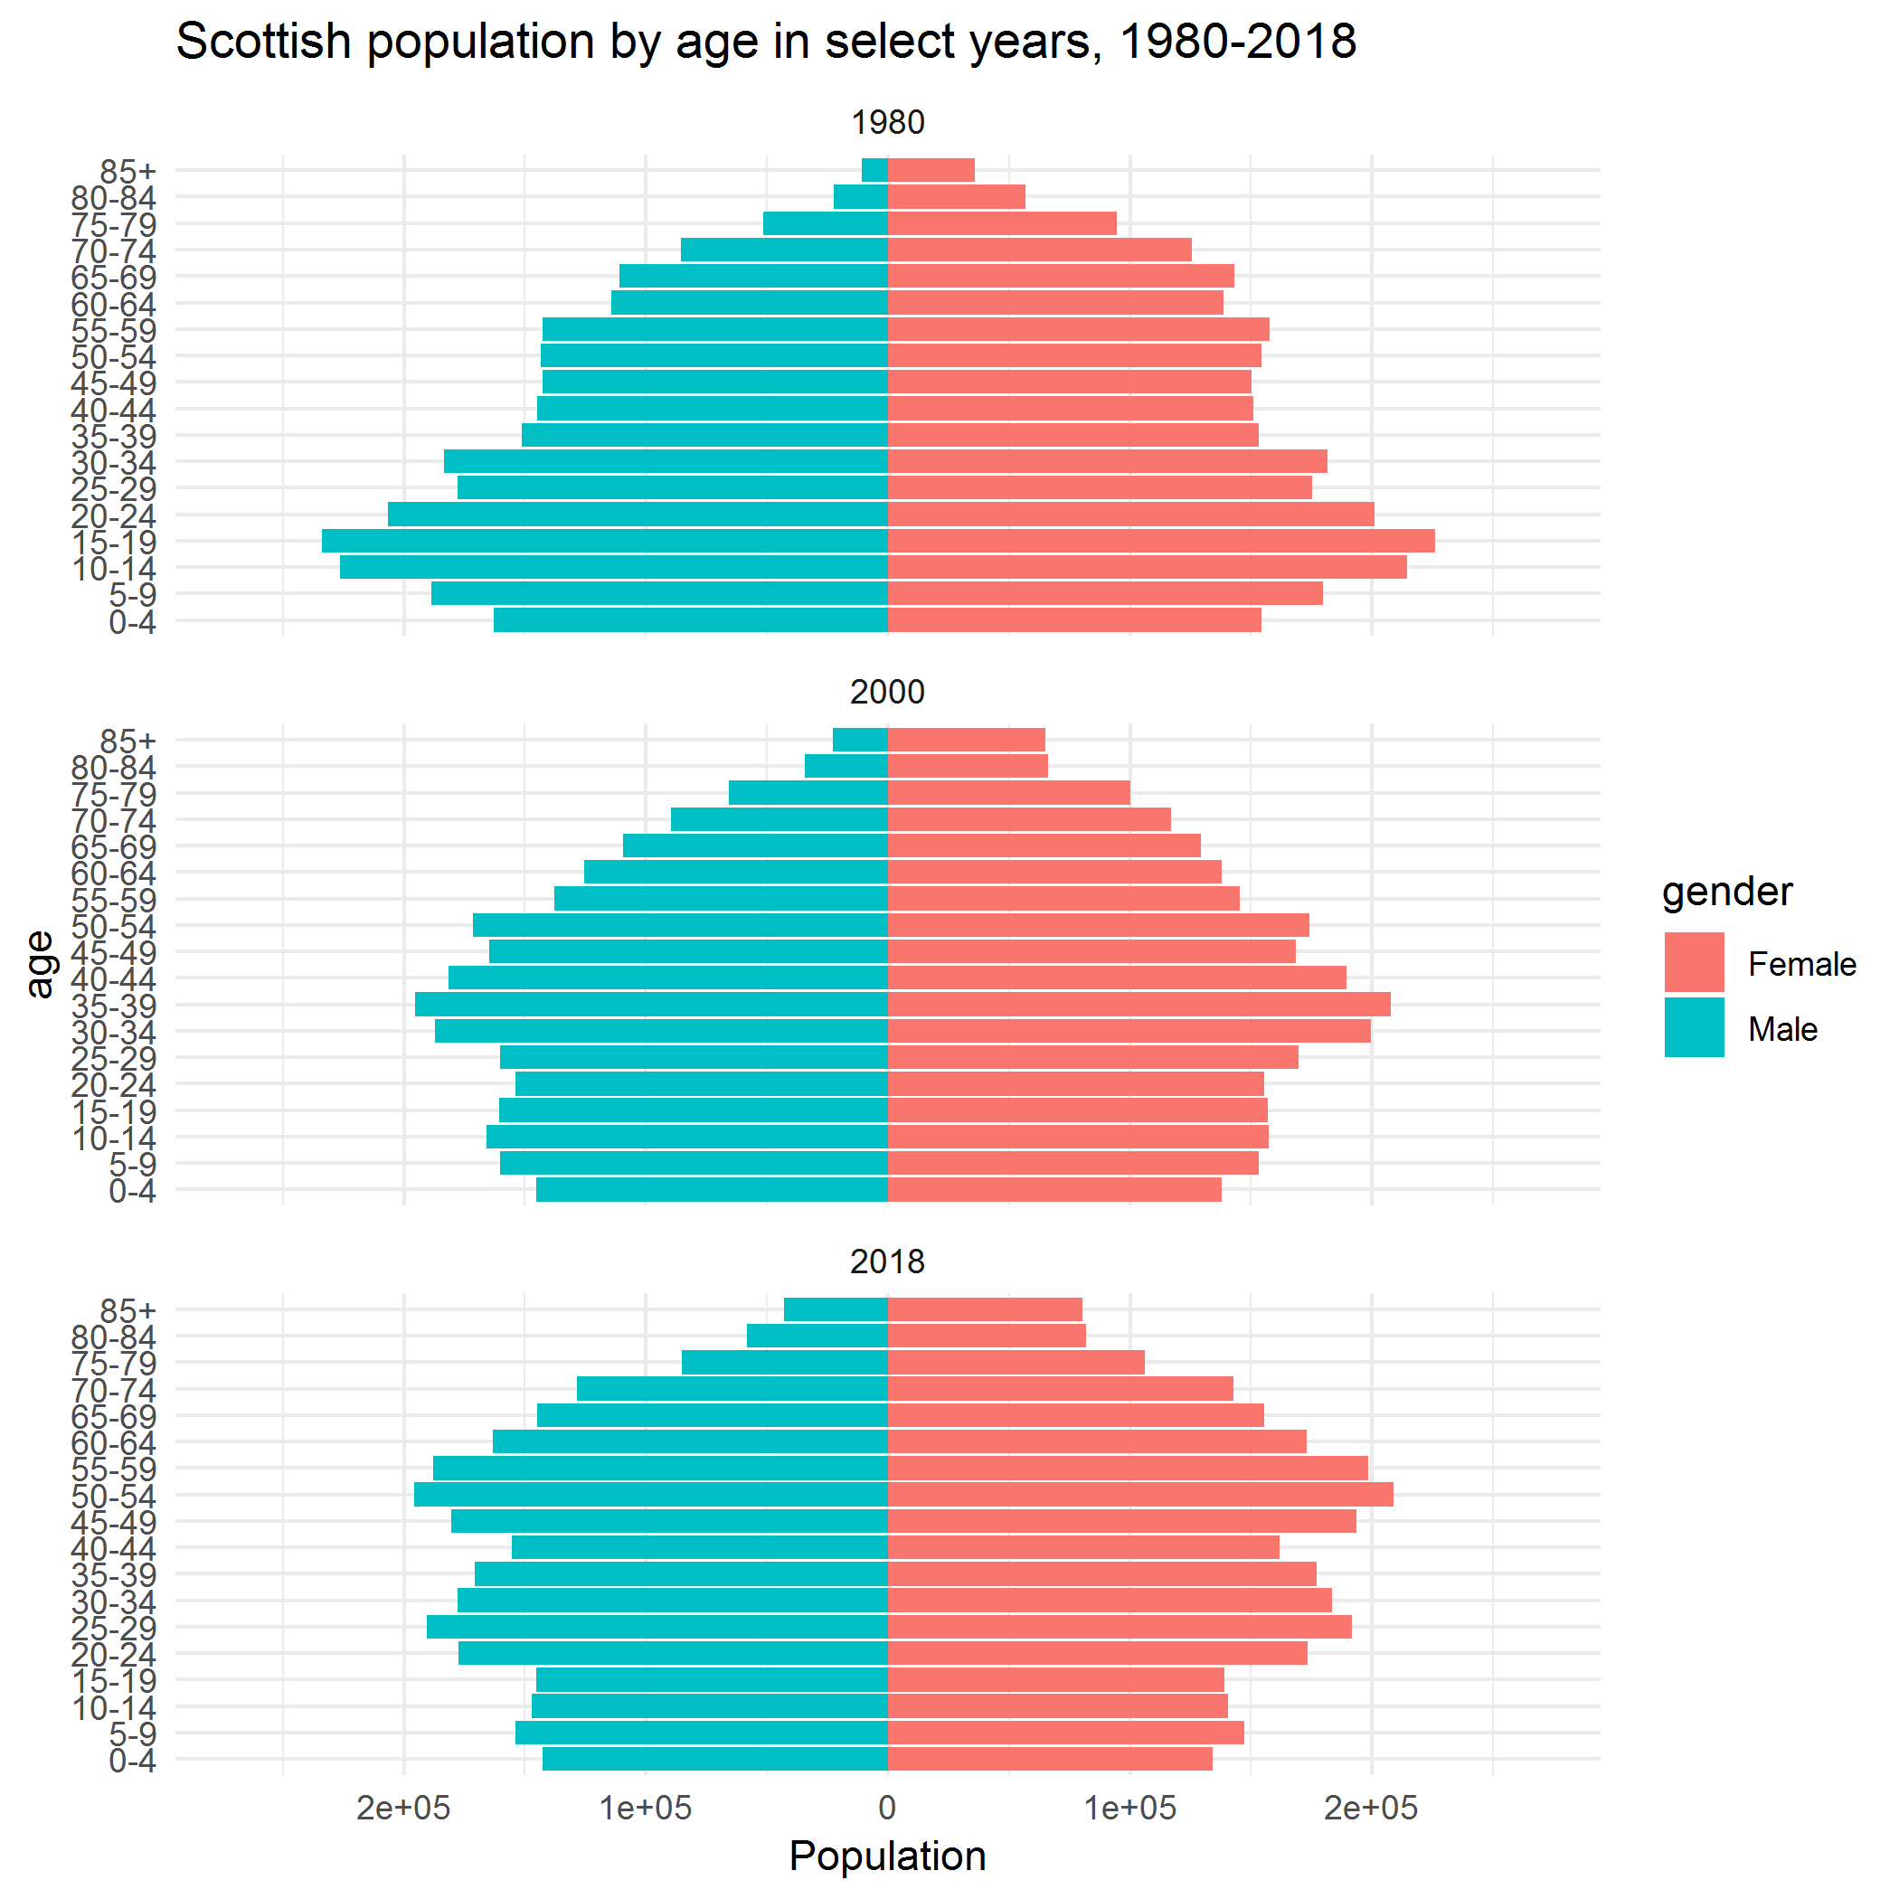
Notes:
So let’s bring this back to the original theme – having a picture that moves is awesome but what is the underlying story that this data is telling? Well most obviously it’s that the population is ageing dramatically. Here are the same figures faceted in 1980, 2000 and 2018. We can see that it looks much more like a pyramid in 1980. Of course this isn’t new, this is a phenomenon happening all over the western world and this is certainly the case in Scotland.
This has serious implications for Scotland’s colleges because not only is Scotland aging but the bottom is falling out of its population, and this is especially the case for the youngest. Now this obviously has important implications for colleges because who do you think their target demographic group is? Let’s take a look at this relationship a little bit closer

Slide 9
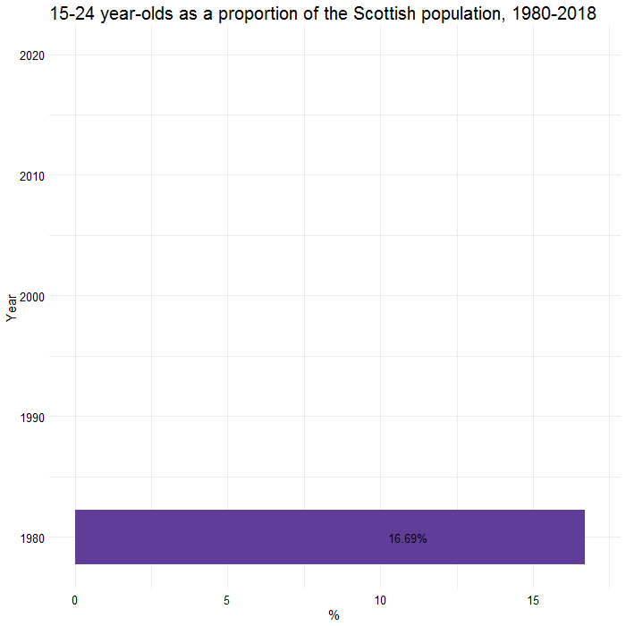
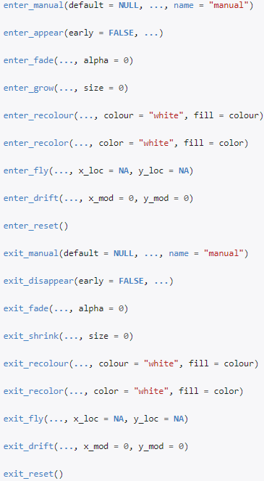
transition_states(Year, wrap = F) +
shadow_mark(colour = 'black') +
enter_grow()
Notes:
Using the same data as before this chart shows 15-24 year olds in Scotland as a proportion of the population. We’ll discuss the implications of this in a moment but first let’s have a look at what’s going on behind the scenes
After my ggplot code I’ve inserted a transition_states call. Now you’ll probably remember that this is quite similar to the transition_time call that was used in the last graph. The difference is that transition_time is suitable for a data where the states represent specific points in time and will correspond with the actual time difference between points. Whereas transition states is almost like the facet_wrap call but in gif format, basically it splits data into multiple states based on the levels in a given variable, in this case year. I used that here because you can see that I’ve got one data point that is not like the other
The second is shadow_mark, which stylises the raw data, you can see I’ve added a black outline because I used the scale_fill_distiller call for colours, and as the years go by the bars get slightly harder to see
The final call is enter_grow. Enter and exit functions control what happens when data does not persist during a tween – As the name suggests, this makes elements gradually grow into existence, but there are so many different variations on what you can do with this

Slide 10
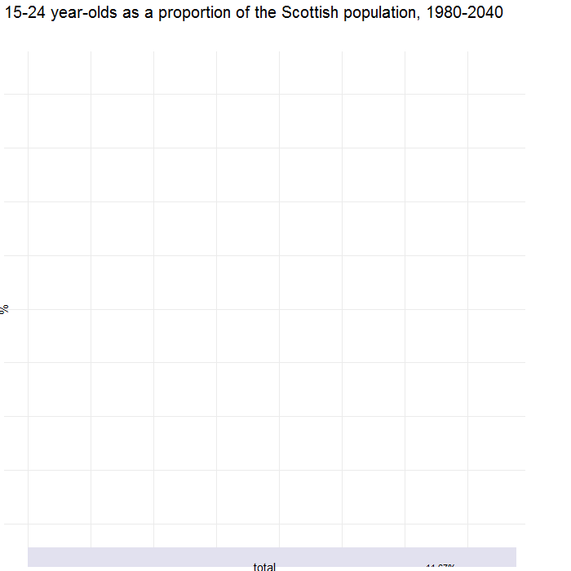
pop_select <- ggplot(data = popdata_final, aes(x=Year, y = total, fill = total)) +
geom_bar(stat="identity") +
labs(title = "15-24 year-olds as a proportion of the Scottish population, 1980-2040", x = "%") +
coord_flip() +
geom_text(aes(label = ifelse(Year %in% c(1980, 2018, 2040), paste0(total, '%'), "")), hjust = 3) +
scale_fill_distiller(palette = "Purples", direction = 1) +
theme_minimal() +
theme(plot.title = element_text(size = 20),
legend.position = "none",
axis.text = element_text(size = 12.5,
color = 'black'),
axis.title = element_text(size = 15),
strip.text = element_text(size = 15)) +
transition_states(transtate, transition_length = 2, state_length = 1, wrap = F) +
shadow_mark(colour = 'black') +
enter_grow() +
view_step(pause_length = 2, step_length = 1, nsteps = 2, wrap = F)
Notes:
Once again, let’s bring it back to our original theme of telling a story with our data. So we know that the bottom is basically falling out of the age pyramid, so I pulled some population projection figures which NRS also produced to have a think about what this will look like in coming years. But when I produced the graph it gave me this?!? I was quite proud of myself because when I was making these visuals I found a bug!

Slide 11
pop_select <- ggplot(data = popdata_final, aes(x=total, y = Year, fill = Year)) +
geom_bar(stat="identity") +
ggstance::geom_barh(stat="identity") +
labs(title = "15-24 year-olds as a proportion of the Scottish population, 1980-2040“, x= "%") +
coord_flip() +
geom_text(aes(label = ifelse(Year %in% c(1980, 2018, 2040), paste0(total, '%'), "")), hjust = 3) +
scale_fill_distiller(palette = "Purples", direction = -1) +
theme_minimal() +
theme(plot.title = element_text(size = 20),
legend.position = "none",
axis.text = element_text(size = 12.5, = 'black'),
axis.title = element_text(size = 15),
strip.text = element_text(size = 15)) +
transition_states(transtate, transition_length = 2, state_length = 1, wrap = F) +
shadow_mark(colour = 'black') +
enter_grow() +
view_step(pause_length = 2, step_length = 1, nsteps = 2, wrap = F)
Notes:
For some reason, the view_step function does not agree with coord_flip, and after scouring stackoverflow for a workaround I found one that suggested instead of using geom_bar, to use geom_barh from the ggstance package, which is another ggplot extension which provides flipped components. In doing so we get rid of our coord_flip call, and also reverse our X and Y variables, and finally we also change our pallete to make sure it’s in the same direction. And then we get this.

Slide 12
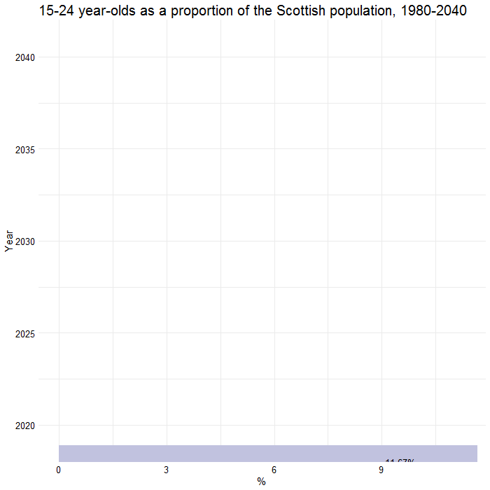
transition_states(transtate, transition_length = 2, state_length = 1, wrap = F) +
shadow_mark(colour = 'black') +
enter_grow() +
view_step(pause_length = 2, step_length = 1, nsteps = 2, wrap = F)
#DATA
#VIEW
Notes:
This is what the aforementioned graph looks like but with corrected axes. You will see that in the first frame it contains the same set of data as in the last graph, 1980 to 2018. But using a mutate call I added a variable called transtate, with the old data being 1 and the new data being 2. Then I’ve specified that it will transition between those two things. Then the next two calls are the same. Then the final call is view_step. Now crucially, transition_states refers to the data, while view_step refers to the view, so in the latter you can see there are two steps – the first extending the view to 2040, and the next zooming in on 2020-2040. I’ve also specified length and such as well.
Any questions here?
So ladies and gentlemen, what’s the story here?
Because everyone likes visuals I’ve got one more to show, this one a line chart

Slide 13
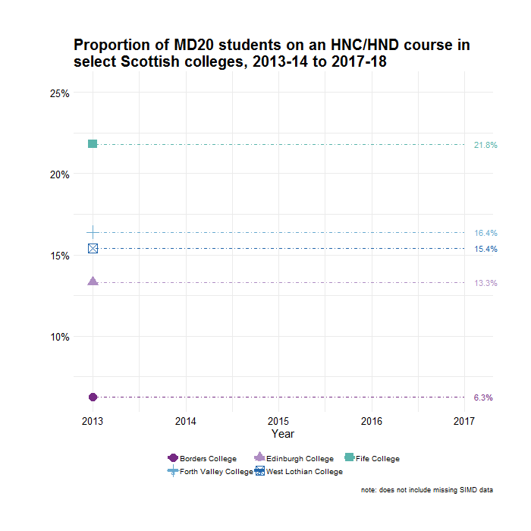
transition_reveal(year) +
ease_aes('cubic-in-out',
interval = .5)
Notes:
This is a chart showing the proportion of MD20 students, i.e. the poorest ones, on HNC/HND courses. This is very important in the case of articulation – has anyone here heard of that? Basically it refers to students on these particular courses matriculating to university with university credit, such that they begin in their second or third year rather than their first. It is a huge SG priority just now in terms of widening access.
To produce the graph, the first step is transition_reveal. You’ll recall that previously we used transition_time for the population pyramid, and then transition_states for the bar chart. Transition_reveal differs from those two because as the name suggests it keeps old data for path and polygon type layers so that they gradually build up together. The second part was my tweening process, I’ve selected ‘cubic-in-out’, which models a power-of-three function both in and out of each data point, my interval is .5. In practice what this means is that you can see that as each line progresses it gradually gets up to speed, then at the halfway point the data label switches, and then it slows down again as it reaches the year.
Now as I mentioned articulation is a huge part of SG’s widening access agenda right now, and a chart like this is very effective if you’re in a room full of college and university administrators. For the former it very quickly contextualises where institutions are in relation to each other, which is a very effective ‘soft power’ method of basically getting them to do a certain thing. And for universities they’re basically licking their chops because a student like this would not only help satisfy their SIMD numbers, but it would also boost their articulation, so they know for example they should concentrate their recruiting at Fife college which has well over twice as many of these students as in Borders.
Transition_reveal calculates intermediary values at exact positions instead of coercing raw values into the closest frame. It further keeps old data for path and polygon type layers so that they are gradually build up instead of being a set of disconnected segments

Slide 14
Closing thoughts
Relatively new package
Surface level overview
Don’t forget the message!
Notes:
Don’t forget message. Consider whether a gif is actually the most effective way to communicate your message – the question is how are you telling your story better with a gif than a traditional static graph? Above all you must use tools to suit your needs rather than trying to shoehorn your message into some kind of format that a gif will most effectively facilitate

